Slide 1
How to Track the Use of Early Childcare Education Recovery Grant (ECEI) Funds
1

Slide 2
LET’S PLAY
ICE BREAKER
3
Notes:
Ask:
Success Story?
Biggest struggle?
What other support does your business need?

Slide 3
Early Care and Education Initiative Grant
General Reporting Requirements
In accepting the ECEI Grant from Montgomery County, you agreed to the following:
The recipient will be able to reopen August 31, 2020
The recipient can demonstrate significant financial loss cause directly or indirectly from COVID-19
The recipient must not use any of grant funds for expenses that are reimbursed by Federal or State government
No grant funds may be used to reimburse wages to an employee for any time the employee was eligible for unemployment insurance benefits.
2
Notes:
During Webinar: Announce the poll

Slide 4
Early Care and Education Initiative Grant
Reporting Requirements
As a grant recipient, you are also required to provide:
Two (2) operational reports
Due December 31, 2020
Due March 31, 2021
3

Slide 5
Early Care and Education Initiative Grant
Business Information
List which grant you received:
Grant Program ( Ages 0-5YO)
Application #
Grant Program ( School Age)
List if you are a
Family Care Provider
Child Care Center
4
Notes:
Note to say in webinar: Make sure to have your original application number

Slide 6
Early Care and Education Initiative Grant
Business Information
Business Information
Name
Phone Number
Address
Business Representative or Contact Person – very important!
Name
Address
Phone Number
E-mail
5
Notes:
Note to say in webinar--This is the person the county will contact in regard to any questions. Be sure that the information is correct and that the person listed here is monitoring emails and phone calls

Slide 7
Early Care and Education Initiative Grant
Personnel Information
You will need to enter the following:
Number of Full Time Employees
Number of Part Time Employees
*This information is based on your current number of employees.
6
Notes:
Notes during webinar: Please note that in this category the owner needs to be included. Please also make sure to include any subcontractors the childcare might have that are related to the operations of the center.

Slide 8
Early Care and Education Initiative Grant
Business Information
In this section you will need to enter the following:
Business CVRS (County Vendor Registration System) ID
https://mcipcc.net/main/homePage.php
7

Slide 9
ECEI Grant
Income Reporting
General Guidelines:
Divide Child Care income by age group
Infants/Toddler (0-2)
Preschool (2-5)
Optional: School Age (6-8)
Tuition Before & After Care
Subsidies/ Scholarship
USDA Food Program
Other Income
PPP Loan
EIDL Loan
MOCO Lottery
Any other Loan/ Grant received by center
8
Notes:
Note during webinar: The income report tracking will be needed for when the income and expense report documents needs to be uploaded, which takes place turns the end of the application. During the process of your filling out the report, you will not see a specific question about the income your childcare center has received.

Slide 10
ECEI Grant
Income Reporting Sample
123 CHILDCARE CENTER - SAMPLE
INCOME
CAPACITY UNDER COVID19 |  |  | 10 KIDS |  | Month: September
 | Fee | Weekly | Monthlly | # Kids | M. Income | # Kids
Tuition Infant/ Toddlers (0-2YO) | $ 300.00 | $ 900.00 | $ 3,600.00 | 3 | $ 1,200.00 | 1
Tuition 2-5 Years Old | $ 220.00 | $ 1,540.00 | $ 6,160.00 | 7 | $ 2,640.00 | 3
Subsides/Scholarship | $ - | $ - | $ -
USDA Food Program | $ - | $ - | $ -
Total Parent Income |  |  |  |  | $ 3,840.00
Other Income/ ECEI |  |  |  |  | $ 7,785.00 | n/a
Other Income/ PPP |  |  |  |  | $ 4,680.00 | n/a
TOTAL REVENUE | $ 520.00 | $ 2,440.00 | $ 9,760.00 | 10 | $ 16,305.00 | 4
9
Notes:
Notes during webinar: The grant funds can be use for any expenses that took place since April 2020. If you do plan on using the ECEI grant to cover some of the expenses in previous months, our recommendation is for you to create an income report for those months, even thought you didn’t have any income. This will allow you to keep a log of the funds you use from the ECEI grant.

Slide 11
Early Care and Education Initiative Grant
Expense Reporting
Provide amount from the grant spent on the items below:
Facilities ( e.g. rent/mortgage, property taxes, maintenance/repairs, utilities, security, etc...)
Payroll/ Benefits ( e.g. salaries, taxes, life insurance, medical insurance, etc...)
Programmatic (e.g. non-capital equipment-furniture, toys, rugs; consumables-paints, crayons, paper; food)
Administrative (e.g. account, Professional Development, license renewals, accreditation fees, technology, office supplies)
Personal Protective Equipment (e.g. gloves, masks, cleaning supplies, thermometers, shoe covers, Plexiglass shields)
Other
10
Notes:
Note to say in webinar:
-The items in bold here is a direct sample of what the grant reporting questionnaire will ask you for. All the categories in bold are the main categories you are going to see as you complete the application. In the next slides I will provide a sample.
Please note that the county understand that things may have changed, and that the budget that you submitted might not match the actual use of funds. The county’s priority is to ensure you account for how the funds were spend.
If a receipt was lost or misplaced, a credit card or check will be needed along with a redacted statement. Moving forward, please make sure that you save all receipts.
The funds can be used to cover expenses from April 2020.

Slide 12
Early Care and Education Initiative Grant
Expense Reporting - Sample
EXPENSES - September
Facilities
SUBCATEGORIES | ACTUAL | Parent Income | ECEI | PPP | OTHER
Mortgage/Rent | $1,500.00 | $0.00 | $1,500.00 | $0.00 | $0.00
Property Taxes | $300.00 | $0.00 | $300.00 | $0.00 | $0.00
Maintenance | $100.00 | $0.00 | $100.00 | $0.00 | $0.00
Repairs | $1,000.00 | $1,000.00 | $0.00 | $0.00 | $0.00
Utilities: Gas | $85.00 | $0.00 | $85.00 | $0.00 | $0.00
Utilities: Water/ Sewer | $175.00 | $0.00 | $175.00 | $0.00 | $0.00
Utilities: Electricity | $257.00 | $0.00 | $257.00 | $0.00 | $0.00
Internet Provider | $119.00 | $0.00 | $119.00 | $0.00 | $0.00
Telephone/ Cellphone | $255.00 | $0.00 | $255.00 | $0.00 | $0.00
Security/Alarm System | $69.00 | $0.00 | $69.00 | $0.00 | $0.00
TOTAL | $ 3,860.00 | $ 1,000.00 | $ 2,860.00 | $ - | $ -
11
Notes:
Note during webinar:
If you are a family childcare, you can count only for 30% of the expense if the childcare is inside your personal property. If any of this categories are 100% on the business name, then you can use the expense at 100%, but if the utilities are in someone's name, then it can only be accounted for 30% . Another expense that can be added in this group for the center is the CAM ( Common area maintenance) charges from the land,
In repairs, I’m showing an example of using parent income to pay for the repair. In the case of my center, I decided to update the flooring in the bathrooms. The reason why this was not applicable under ECEI is because I chose to make such upgrade for cosmetic reasons.

Slide 13
Early Care and Education Initiative Grant
Expense Reporting - Sample
Sample 1: Using Payroll under ECEI
EXPENSES - September
Payroll/ Benefits
SUBCATEGORIES | ACTUAL | Parent Income | ECEI | PPP | OTHER
Salaries | $4,000.00 | $0.00 | $4,000.00 | $0.00 | $0.00
Employee Bonus | $1,500.00 | $1,500.00 | $0.00 | $0.00 | $0.00
Payroll Taxes | $680.00 | $0.00 | $680.00 | $0.00 | $0.00
Medical insurance | $500.00 | $0.00 | $500.00 | $0.00 | $0.00
Worker's Compensation | $150.00 | $0.00 | $150.00 | $0.00 | $0.00
Life insurance | $250.00 | $0.00 | $250.00 | $0.00 | $0.00
Total | $ 7,080.00 | $ 1,500.00 | $ 5,580.00 | $ - | $ -
Sample 2: Using Payroll under PPP
EXPENSES - September
Payroll/ Benefits
SUBCATEGORIES | ACTUAL | Parent Income | ECEI | PPP | OTHER
Salaries | $4,000.00 | $0.00 | $0.00 | $4,000.00 | $0.00
Employee Bonus | $1,500.00 | $1,500.00 | $0.00 | $0.00 | $0.00
Payroll Taxes | $680.00 | $0.00 | $0.00 | $680.00 | $0.00
Medical insurance | $500.00 | $0.00 | $500.00 | $0.00 | $0.00
Worker's Compensation | $150.00 | $0.00 | $150.00 | $0.00 | $0.00
Life insurance | $250.00 | $0.00 | $250.00 | $0.00 | $0.00
Total | $ 7,080.00 | $ 1,500.00 | $ 900.00 | $ 4,680.00 | $ -
12
Notes:
Note during webinar: Salaries should include the business owner if he/she was in payroll. If the employee or contractor received unemployment insurance benefits, you cannot use the funds to backpay or pay your employees for the same period they received unemployment benefits.
In the salaries section, you can also include any subcontractors that you might of hire for any additional programs such us as music, art, or any other program added to the center. In here, I also provide 2 examples as to how the funds could be use thru 2 different income streams. The 1st sample is using all the ECEI funds to cover for salaries and payroll taxes. The sample 2 shows you how the funds can be distributed between PPP and ECEI.

Slide 14
Early Care and Education Initiative Grant
Expense Reporting - Sample
EXPENSES - September
Programmatic
SUBCATEGORIES | ACTUAL | Parent Income | ECEI | PPP | OTHER
Non-Capital Equipment | $0.00 | $0.00 | $0.00 | $0.00 | $0.00
Furniture | $1,250.00 | $0.00 | $1,250.00 | $0.00 | $0.00
Toys | $145.00 | $0.00 | $145.00 | $0.00 | $0.00
Rugs | $250.00 | $0.00 | $250.00 | $0.00 | $0.00
Art Program | $0.00 | $0.00 | $0.00 | $0.00 | $0.00
Crayons/ paint | $50.00 | $0.00 | $50.00 | $0.00 | $0.00
Paper | $120.00 | $0.00 | $120.00 | $0.00 | $0.00
Food | $350.00 | $0.00 | $350.00 | $0.00 | $0.00
Total | $2,165.00 | $0.00 | $2,165.00 | $0.00 | $0.00
13
Notes:
Note during webinar:
This category is where you track all your expenses for the actual program itself. Non-capital equipment is an asset with an acquisition cost of $1000 or more, but less than $ 5,000.
If the center has a vehicle to transport children, we will include such as vehicle payment, vehicle repair and vehicle insurance under this category

Slide 15
Early Care and Education Initiative Grant
Expense Reporting - Sample
EXPENSES - September
Administrative
SUBCATEGORIES | ACTUAL | Parent Income | ECEI | PPP | OTHER
Professional Development | $175.00 | $0.00 | $175.00 | $0.00 | $0.00
License Renewals | $0.00 | $0.00 | $0.00 | $0.00 | $0.00
Accreditation Fees | $55.00 | $0.00 | $55.00 | $0.00 | $0.00
Technology | $69.00 | $0.00 | $69.00 | $0.00 | $0.00
Office Supplies | $195.00 | $0.00 | $195.00 | $0.00 | $0.00
Business Insurance - Liability | $0.00 | $0.00 | $0.00 | $0.00 | $0.00
Professional Fees ( e.g. accountant) | $300.00 | $0.00 | $300.00 | $0.00 | $0.00
Total | $ 794.00 | $ - | $ 794.00 | $ - | $ -
14
Notes:
Note during webinar:
In this category you can also add the cost of an accounting software, zoom, any development classes for your staff, zoom, etc.
- In here you can also add transportation expenses.

Slide 16
Early Care and Education Initiative Grant
Expense Reporting - Sample
EXPENSES - September
Personal Protective Equipment ( PPE)
SUBCATEGORIES | ACTUAL | Parent Income | ECEI | PPP | OTHER
Gloves | $75.00 | $0.00 | $75.00 | $0.00 | $0.00
Masks | $100.00 | $0.00 | $100.00 | $0.00 | $0.00
Cleaning Supplies | $150.00 | $0.00 | $150.00 | $0.00 | $0.00
Thermometers | $95.00 | $0.00 | $95.00 | $0.00 | $0.00
Shoe Covers | $46.00 | $0.00 | $46.00 | $0.00 | $0.00
Plexiglass Shields | $500.00 | $0.00 | $500.00 | $0.00 | $0.00
Total | $ 966.00 | $ - | $ 966.00 | $ - | $ -
15
Notes:
Note during webinar:
Please note that there is no limit in the amount of funds you use in this category. We do understand that you might have put a number during your original application; however, the county is looking as for how the funds were actually spent.
It might be the case where you might of bought this item and grouping them together also works. Just make sure your subcategory is labeled properly.

Slide 17
Early Care and Education Initiative Grant
Expense Reporting - Sample
EXPENSES - September
Other
SUBCATEGORIES | ACTUAL | Parent Income | ECEI | PPP | OTHER
Advertising | $100.00 | $0.00 | $100.00 | $0.00 | $0.00
 | $0.00 | $0.00 | $0.00 | $0.00 | $0.00
 | $0.00 | $0.00 | $0.00 | $0.00 | $0.00
Total | $ 100.00 | $ - | $ 100.00 | $ - | $ -
16
Notes:
Note during webinar: In here you guys can track other expenses such as advertising. So let’s say I used Facebook to advertise my business and reopening, then here is where I will add such expense.

Slide 18
Early Care and Education Initiative Grant
Summary of Income/ Expense - Sample
SUMMARY SAMPLE - SEPTEMBER
 | ACTUAL | PAID W/ TUITION | PAID BY ECEI | PAID BY PPP
TOTAL INCOME | $ 16,305.00 | $ 3,840.00 | $ 7,785.00 | $ 4,680.00
TOTAL EXPENSES | $ 14,965.00 | $ 2,500.00 | $ 7,785.00 | $ 4,680.00
BALANCE | $ 1,340.00 | $ 1,340.00 | $ - | $ -
17
Notes:
Note during webinar:
Here is a quick example of a summary of income and expenses that I put together. In white, you guys can see the actual income and expenses. Then, I categorize the income stream and expenses under each specific category as I might be using parents paid tuition to cover some expenses, as well as ECEI grant and PPP Loan.
Based on this sample, I have a profit in the parent’s income stream as I didn’t use all the funds.

Slide 19
Early Care and Education Initiative Grant
Children
You will need to have the following information categorized by age groups. This is for current enrollment:
Total number of children served from 0-5 YO
Total number of children served that are Montgomery County residents
Total number of Special Needs children
*This information is based on your current enrollment.
18

Slide 20
Early Care and Education Initiative Grant
Facilities Located in Targeted Zip Codes
If the facility is located in any of the following zip codes, enter your current total number of children:
20877
20886
20902
20866
20906
*This information is based on the location of your Child Care Center
*If your Child Care Center is not located in the zip codes listed above, simply enter zero
19
Notes:
Note to say during webinar: Please, this is based on where your center is located, not where the children live.

Slide 21
Early Care and Education Initiative Grant
Subsidies
You will need to fill in how many children 0-2 and how many children 2-5 received state subsidies or WPA subsidies. Enter the information for state subsidies and WPA subsidies separately.
*If your Child Care Center doesn’t have any of the programs listed above, leave the response blank
20

Slide 22
Early Care and Education Initiative Grant
Children
Number of Children served who are Montgomery County Residents by Age Group
Total number of children served as Infant/ Toddler ( 0-2 YO)
Total number of children served as Preschool ( 2-5 YO)
*This information is based on your current enrollment.
*If your Child Care Center doesn’t have any children in one of these age groups, leave the response blank
21

Slide 23
Early Care and Education Initiative Grant
Document Requirements
The following documents need to be uploaded:
Income/Expense Report & Receipts
Maryland Childcare License
Excels Certificate (only if you have this certification)
(https://marylandexcels.org/)
*File formatting accepted: JPEG, PDF, Word, Excel
*After uploading the document, make sure to click “upload “
22
Notes:
Note to say during webinar:
The Income/Expense report along with receipts, and Childcare license are documents you must upload. The excels certificate is only applicable if you have it. Also, if you do not upload a document on the categories listed above, you will not be able to proceed to the next page and you will get an message in red saying “ You have not uploaded a file. Please upload a file to continue”.
Please note that the county prefers to received PDF documents.
My recommendation about Income/ Expense Report will be to submit 1 PDF or Excel Spreadsheet that contains all financial information
My recommendation about Receipts will be to track them monthly and separate them by the categories listed previously which are Facilities, Payroll & Benefits, Programmatic, Administrative, PPE, and other.

Slide 24
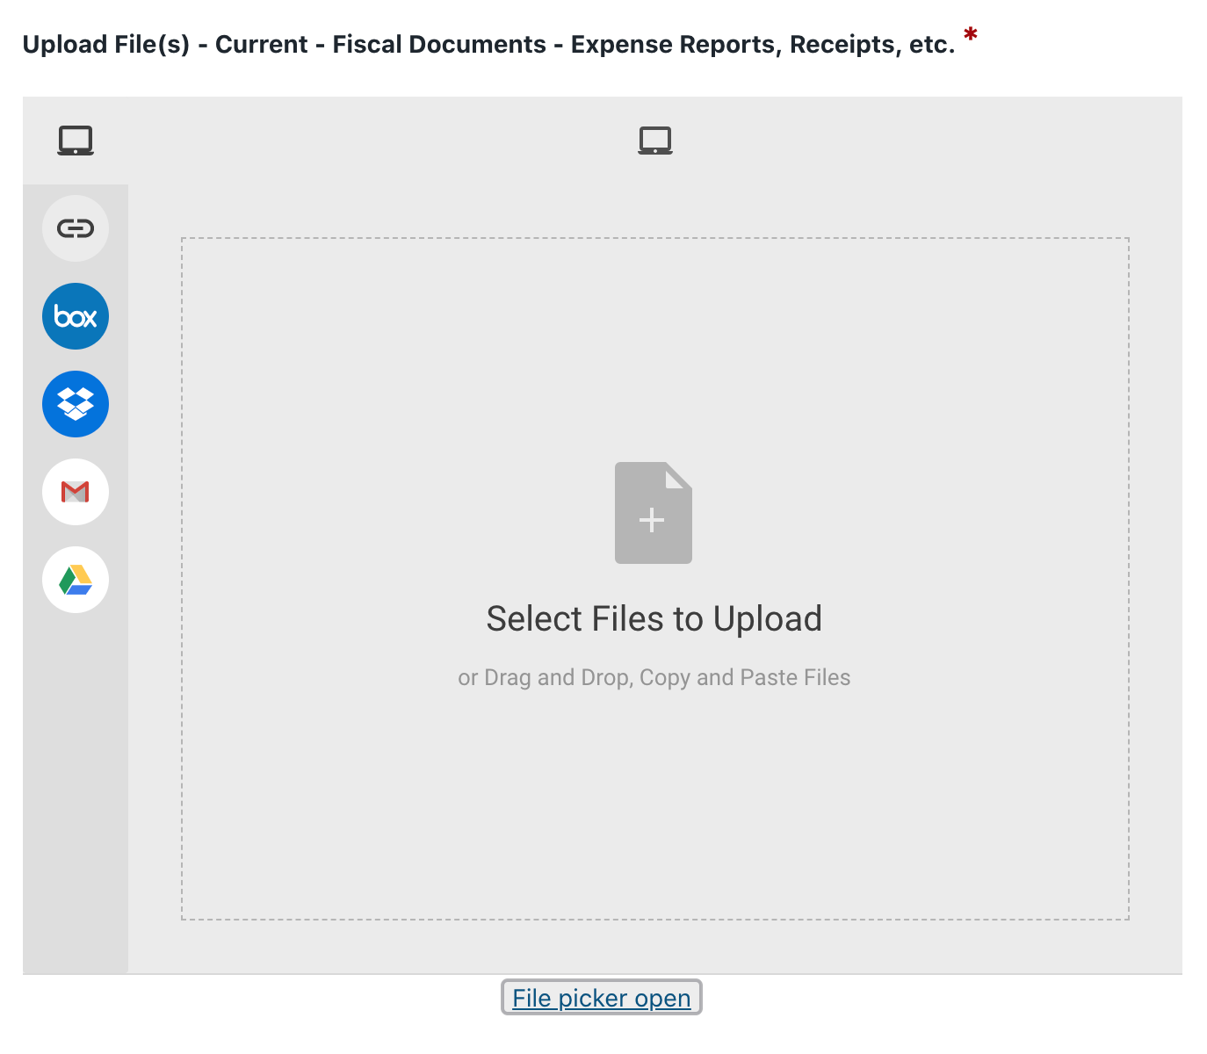
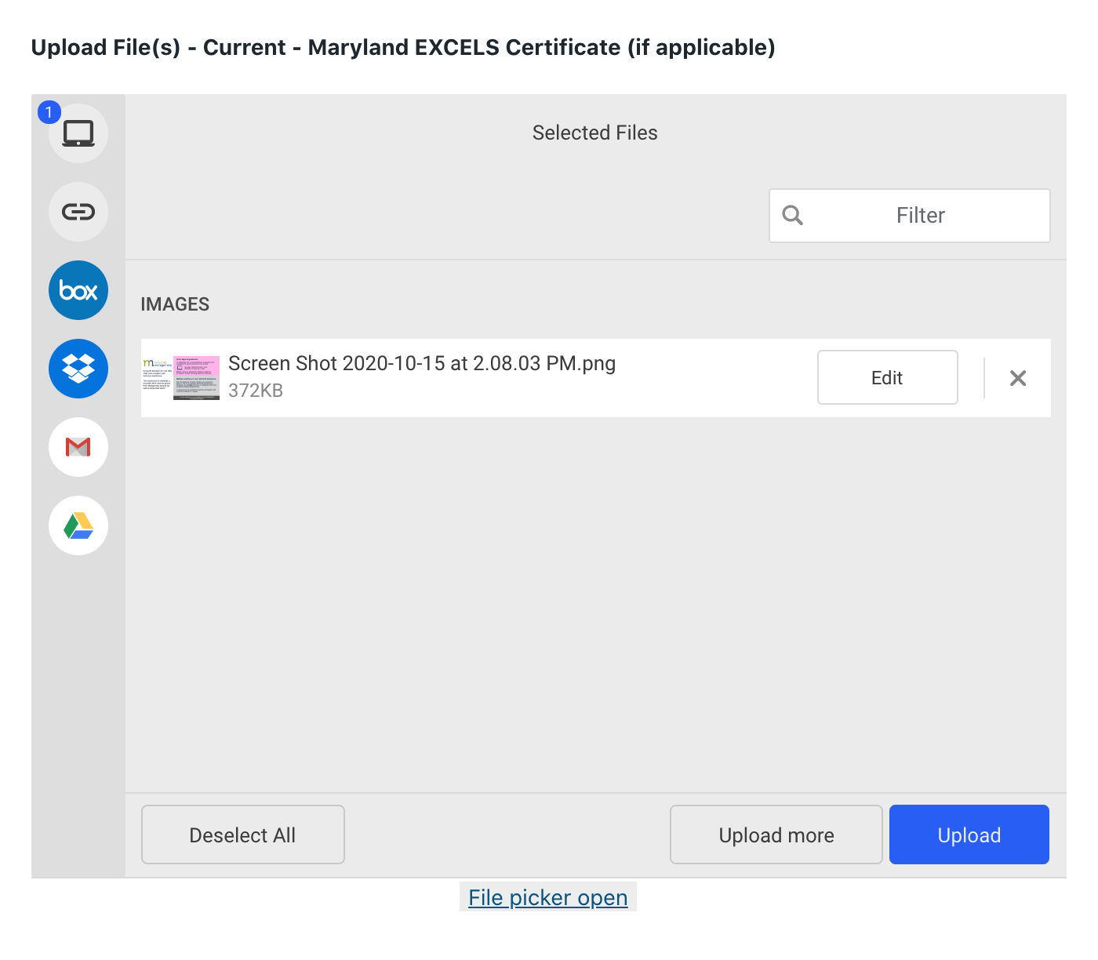
Early Care and Education Initiative Grant
Upload Documents
23
Notes:
Note to say in webinar: Here is a sample of how the system works when you get to the page where you need to upload your documents. Once you add the document, please make sure to click the blue button that says ”upload” otherwise your document won’t be added to the system. I do recommend that you take a screenshot of this page, once you have uploaded all your documents. In the next slide, you are going to see how the system looks once the documents have been uploaded.

Slide 25
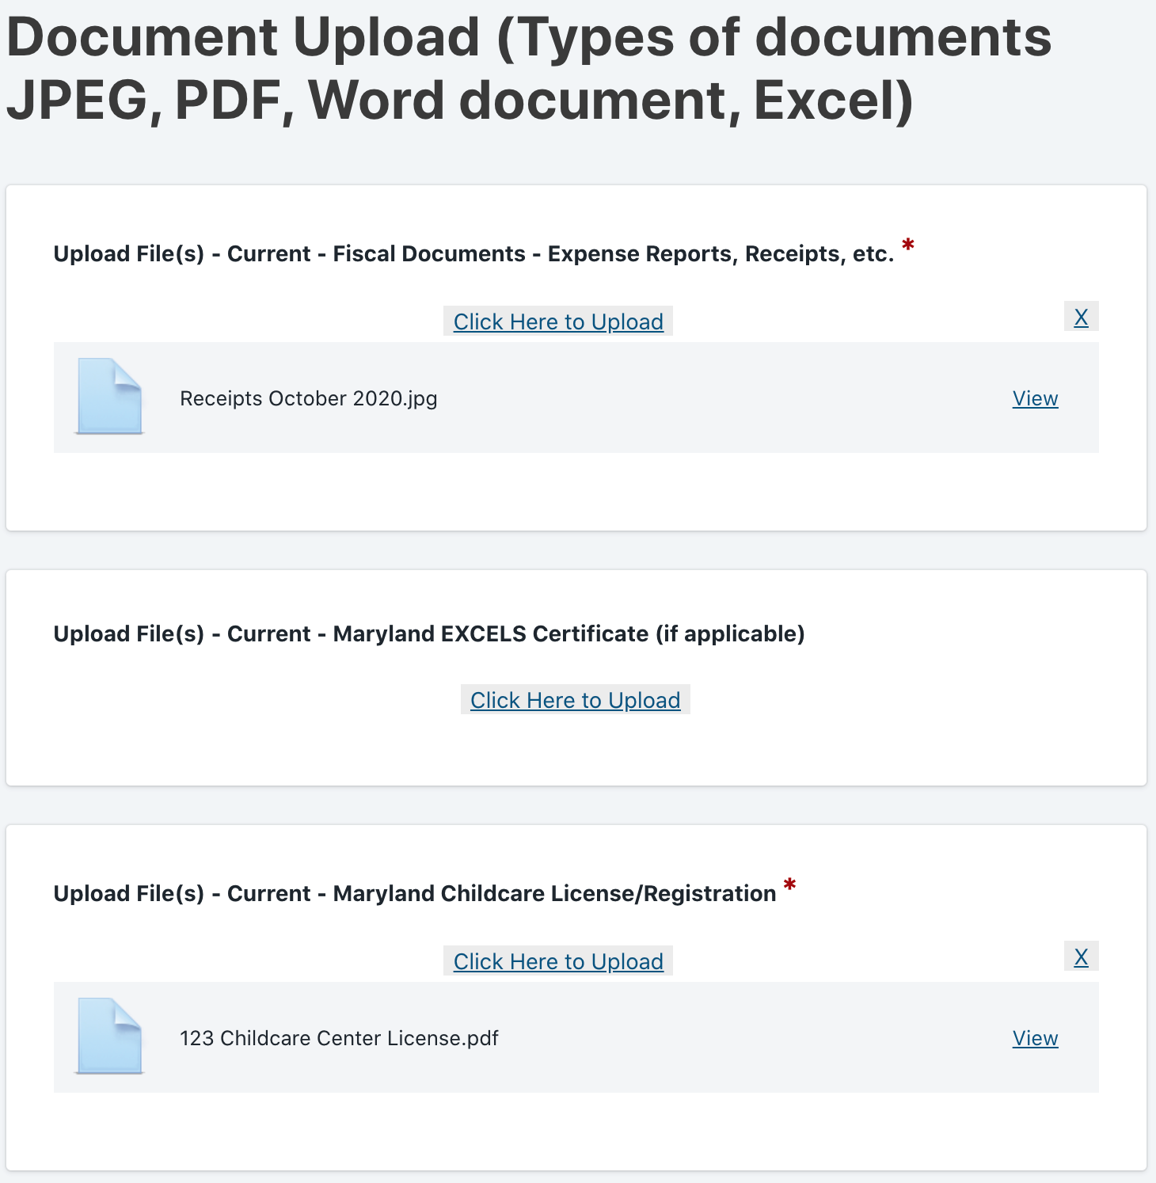
Early Care and Education Initiative Grant
Upload Requirements
24
Notes:
Note to say during webinar: Here is a preview of what the page looks like after you upload your document correctly. As you can see, the items with a red asterisk must be completed. Also, the system does allow you to upload multiple documents.

Slide 26
Early Care and Education Initiative Grant
Provider Consent, Confirmation & Signature
On this page you will need to enter the following information:
First Name
Last Name
E-mail
Draw or Type an electronic signature
By completing and signing this page, you agree to the following
The information being provided on the report is true, correct and complete.
The County may contact you by telephone or e-mail
25
Notes:
Note to say in webinar: This is the last page of the application. Please be consistent with the e-mail that is enter here and the e-mail that was use at the beginning of the application. This will allow the county to be able to contact you, so it is extremely important to double check all the information is correct and not misspelled. Once you click submit, you will be given a receipt number for your record, please make sure to keep that and as mentioned previously, we recommend taking a screenshot of it. In addition, you will be diving the option of downloading a PDF version of your application. We highly recommend that you download the document as you cannot access this application after submittal.

Slide 27
Early Care and Education Initiative Grant
Reminders
Report is due March 31, 2021
The County will email a link for the final report to the contact person listed on the original application or you can use this link https://forms.montgomerycountymd.gov/f/Providergrantreport
You are not able to save the application and come back to add information
Anything with a red asterisk (*) must be filled out
Take screenshots of each page as it is completed in case there is a technical problem, including the signature and submit pages
This presentation will be posted on Non-Profit Montgomery website for your reference, along with an FAQ document
Do not wait until last minute to submit this report! It is best to submit at least 24 hours ahead of the due date.
26

Slide 28
Early Care and Education Resources
NonProfit Montgomery ECE Resources
https://www.nonprofitmoco.org/ecei/
Technical assistance including one-on-one support, webinars, resources, and tools for providers
Montgomery Moving Forward (MMF) ECE Online Resources + Workforce Advocacy Coalition
https://www.nonprofitmoco.org/mmf/ece/
Information about MMF’s work to support the ECE workforce and information about how to get involved in advocacy to support ECE at County, state, and federal levels
MMF ECE Toolkit
https://www.ecetoolkit.org/
resource for employers in Montgomery County, Maryland. This Toolkit presents information and resources on what employers can do to support working parents with young children, including resources for parents
Montgomery County Child Care Resource and Referral Center
https://www.montgomerycountymd.gov/HHS-Program/CYF/MCCCRRC/Index.html Assists parents in locating licensed childcare, provides resources for providers in both family care and centers, provides training for childcare professionals
27

Slide 29
Early Care and Education Resources
Maryland Family Network
https://www.marylandfamilynetwork.org/for-providers
Statewide Network to address the needs of parents, childcare providers, and children. Network of Child Care Resource Centers offer training, mentoring, coaching, and other supports to Maryland’s childcare workforce
Maryland Family Child Care Association
https://www.msfcca.org/
Aims to educate, unify and advocate to strengthen the profession of family childcare; enriching the lives of providers, children, families and communities.
Maryland State Child Care Association
https://mscca.org/
Promotes the growth and development of professional licensed childcare and learning centers in Maryland
28

Slide 30
Other Business Resources
MD SBDC
http://www.mdsbdc.umd.edu/
Statewide Network that offers training and no cost 1-on-1 counseling to business owners. Service is available in English and Spanish.
Women’s Business Center
https://marylandwbc.org/
Business Center that provides training and 1-on1 counseling to business owners. Service is available in English and Spanish.
Latino Economic Development Center
https://www.ledcmetro.org/
Development center that offers training and no cost 1-on-1 counseling to business owners. In addition, they provide business financing. Service is available in English and Spanish.
29

Slide 31
We are here to help you!
Non-Profit Montgomery is providing FREE technical assistance to
Child Care Centers
Available in English & Spanish
E-mail: ecei.relief@gmail.com
Phone: 301-349-6373
Website: https://www.nonprofitmoco.org/ecei/
Friday, February 26, 12:00 PM
30
Women’s Business Center is providing FREE technical assistance
For Family Childcares
Martha Jimenez – martha@marylandwbc.org

